Slide 1
graphs
Part two

Slide 2
Recap
A graph G is made up from two finite sets
Set of vertices V = {v₁ , v₂ , v₃ , ..., v_{k}}
Set of edges E = {( v₁, v₅ ), ( v₂, v₃),.. }
which show which vertices are connected

Slide 3
Terminology
Let G be V ={a,b,c,d,e} and E = {(a,b) (d,e) (b,d) (c,e)}
Here are three graphs which could be described by these two sets
d
a
b
a
b
c
e
a
b
d
c
d
c
e
e

Slide 4
Simple Graphs
Simple – no loops, no multiple edges
Not simple (loop)
Not simple (multiple edge)

Slide 5
Walk, Paths & Trails
All sequences of edges around a graph from vertex to vertex are walks. Some of them have special properties.
Graph, G
A
A
If all the edges of a walk are distinct we have a trail.
e.g. A,B,C,D,B
B
B
A
B
C
C
D
D
If all the vertices of a walk are distinct we have a path.
e.g. B,A,C,D
Walks can be given as a sequence of edges AB, BC, CB
But more commonly by the sequence of vertices A,B,C,B
C
D

Slide 6
Trees
A connected graph with no cycles is called a tree
Not a tree
Has a cycle
Not a tree
Not connected
A tree

Slide 7
Spanning trees
A spanning tree of a graph
is a special subgraph which includes
all the vertices of G and is
also a tree.
Spanning trees
If G has n vertices, a spanning tree will have n - 1 edges

Slide 8
Adjacency Matrices
Adjacency matrices can easily be used to describe the connections of a graph and input them into a computer
If A is the adjacency matrix of G then the entry a_{ij} = 1 if there is an edge between v_{i} and v_{j}. Otherwise the entry is 0.
v₁ v₂ v₃ v₄
v₁
v₂
v₃
v₄
A=

Slide 9
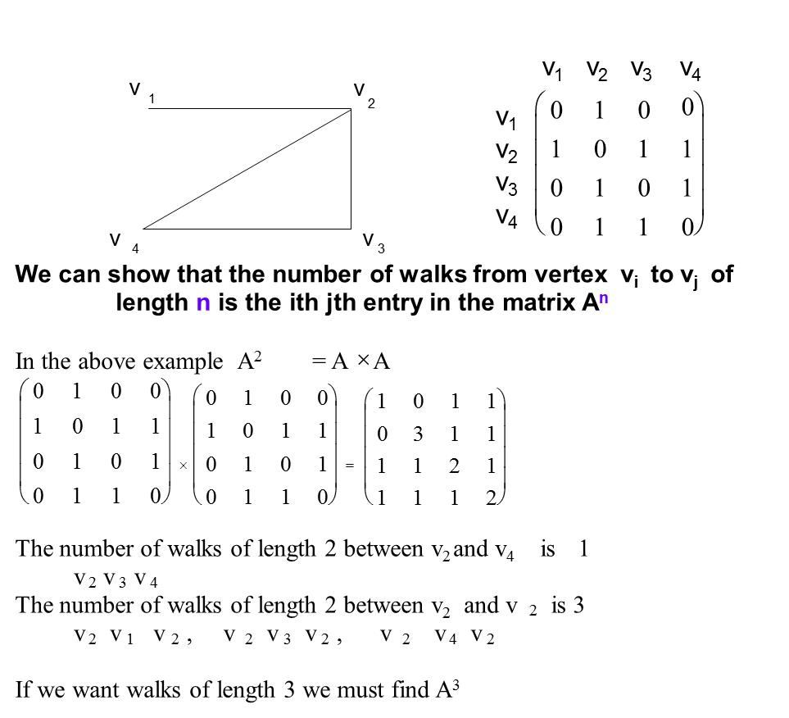

Slide 10
Weighted graphs

Slide 11
A weighted graph is a graph which has a number attached weights associated with each edge can represent to each of its edges.
Eg. Five towns A, B, C, D, E are connected by roads of the following lengths. Put this in the form of a weighted graph.
A
28
13
A
B
C
D
E
31
A
31
28
1
3
D
40
B
43 10
43
C
C
40 12
B
10
12
this is NOT a matrix but just a table showing the distances (like in a book of maps)
E

Slide 12
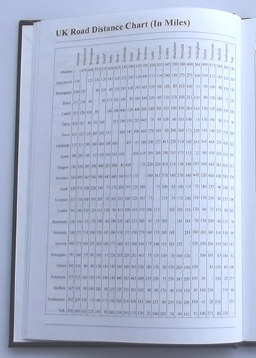
Weights
The weights associated with each edge can represent
cost,
time,
distance,
data traffic
or any other quantity we are interested in measuring between the vertices of our graph
Once we have weights associated with the edges of a graph we can try and minimise or maximise totals or take lowest or highest weighted paths through the graph.

Slide 13
5
Downstairs
Lounge
Upstairs
Bedroom 2
3
15
20
12
Upstairs
Bedroom 1
Loft
Bedroom 3
10
You have to make a network from these 4 computers in a house (not drawn to scale)
The cabling distances are shown in metres
What is the best way to connect them all?
Answer: Choose the 3 smallest distances

Slide 14
Floor3
UK HQ
USA Cluster A
Floor 2
UK HQ
USA Cluster B
You have to make connections between these 4 clusters of computers
The two on the left are on different floors of a building in London
The two on the right are in USA in one building
What is the best way to connect them all?
Answer: any of the 4 transatlantic connections will do and then connect the 2 clusters within each country

Slide 15
Cabling costs between computers can be shown on a weighted graph and here we find the minimum cost of connecting all the computers up would be £27 (Using a minimal spanning tree)
£4
£12
£15
£8
£5
£10
£9

Slide 16
Alternatively the maximum time to allow for a job to be completed can be calculated in scheduling problems like this very simple one.
Here we find that to get the baked beans on toast will take at least 220 seconds as this is the maximum ‘walk’ from start to finish
10s
180s
30s
FINISH
START
10s
20s
150s

Slide 17
Minimum Spanning trees
Suppose that G is a weighted graph. A minimum spanning tree is a spanning tree of G which minimises the weights on the edges in the tree.
Kruskal's algorithm (also known as the greedy algorithm) finds a spanning tree with the minimum weight
There may be more than one spanning tree with this smallest weight

Slide 18
Kruskal’s Algorithm
This method builds the tree as you go along starting with just the vertices
Algorithm
1 The graph T initially consists of the vertices of G and no edges.
2 Add an edge to T having minimum weight but which does not give a cycle in T.
3 Repeat 2 until T has n - 1 edges.

Slide 19
Kruskal's algorithm
Step 1
Label vertices
B
4
12
Step 2
Write a list of edges
in order of magnitude
A
C
15
8
10
5
E
9
D
Step 3
Build a spanning tree from the vertices
Accepting each edge in order IF no cycle is formed
BC 4
CD 5
CE 8
DE 9
B
AE 10
A
C
Total for this tree will be found by adding up the edges accepted
4+5+8+10 = 27
AB 12
BE 15
E
D

Slide 20
Edge | Weight
e1 | 11 | Accept
e2 | 12 | Accept
e3 | 15 | Reject
e4 | 15 | Accept
e5 | 16 | Accept
e6 | 16 | Accept
e7 | 16 | Reject
e8 | 17 | Reject
e9 | 18 | Reject
e10 | 20 | Accept
e11 | 24 | Reject
Kruskal's algorithm
from notes
The minimum length of cable is 16+16+12+11+15+20=90

Slide 21
Points to note
You must arrange the edges in increasing size, checking that you haven’t left any out.
You must add the edges to the tree in the right order, it may not connect at first
If two edges are the same it does not matter which order you put them
Not all answers will be the same but all minimal spanning trees will give the same totals
Your final tree should have n-1 edges for a graph with n vertices
This is calculating something different from Dijkstra’s algorithm which is concerned with the shortest routes in a graph from each vertex to a given source node.

Slide 22
B
C
18
A
10
20
F
15
Minimum spanning tree has total length
15+10+15+20+18 =78
E
D
15
B
C
25
20
18
30
A
10
20
F
15
25
22
15
D
E

Slide 23
Multigraphs
These are graphs which have loops or multiple edges.

Slide 24

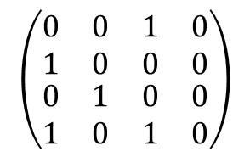

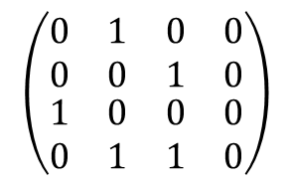
Directed Graphs - A directed graph is a graph with a direction assigned to each edge
The adjacency matrix A has now lost its symmetry as there is a connection from
B to A but not A to B
$$\left(\begin{matrix}\begin{matrix}0 & 0 \\ 1 & 0\end{matrix} & \begin{matrix}1 & 0 \\ 0 & 0\end{matrix} \\ \begin{matrix}0 & 1 \\ 1 & 0\end{matrix} & \begin{matrix}0 & 0 \\ 1 & 0\end{matrix}\end{matrix}\right)$$
$$A=$$
Finding A⁴
We see A⁴ = A
A
B
$$\left(\begin{matrix}\begin{matrix}0 & 1 \\ 0 & 0\end{matrix} & \begin{matrix}0 & 0 \\ 1 & 0\end{matrix} \\ \begin{matrix}1 & 0 \\ 0 & 1\end{matrix} & \begin{matrix}0 & 0 \\ 1 & 0\end{matrix}\end{matrix}\right)$$
$$A^{2}=$$
No walks of length 2 from A to A
C
D

Slide 25
Directed or Rooted Trees
For organising data and storing it in a logical way we often use a rooted tree structure.
A starting vertex is called the root, r, as all vertices are accessible from this r.
There is a direction to the edges and w is called a successor of vertex v if there is an edge from v to w
r
v
w

Slide 26
Binary Trees
A binary tree T is a directed tree such that each
vertex v has at most two successors.
Each successor is either called a left successor,
left(v) or a right successor, right(v).
v cannot have two left or two right successors.
r
v
left(v)
right(v)

Slide 27
Use of tree structures
((p∧q)∨r) ∧((q∨r) ∧ (p∨r))
is a logical expression composed of the propositions p, q and r joined
with operators. We can show its construction by breaking this down to
its components using a tree structure
Once an expression can not be decomposed any further you have reached a terminal
((p∧q)∨r) ∧((q∨r) ∧ (p∨r))
∧
((p∧q)∨r)
(q∨r) ∧ (p∨r)
∨
∧
(p∧q)
r
(q∨r)
(p∨r)
∧
∨
∨
p
q
q
r
p
r

Slide 28
Evaluation
We can use this structure to evaluate ((p∧q)∨r) ∧((q∨r) ∧ (p∨r)) when the original propositions are given truth values
e.g. if p = T q = T r = F
T
((p∧q)∨r) ∧((q∨r) ∧ (p∨r))
∧
T
((p∧q)∨r)
(q∨r) ∧ (p∨r)
T
∨
∧
(p∧q)
(q∨r)
T
F
T
T
r
(p∨r)
∧
∨
∨
p
T
q
T
T
q
r
p
r
F
T
F

Slide 29
Evaluation
We can use this same structure to evaluate ((p∧q)∨r) ∧((q∨r) ∧ (p∨r)) when the original propositions are given different truth values
e.g. if p = F q = T r = F
F
((p∧q)∨r) ∧((q∨r) ∧ (p∨r))
∧
F
((p∧q)∨r)
(q∨r) ∧ (p∨r)
F
∨
∧
(p∧q)
(q∨r)
F
F
T
F
r
(p∨r)
∧
∨
∨
p
F
q
T
T
q
r
p
r
F
F
F

Slide 30
From the notes
This is the tree for (p∧(q∨¬r)) ∨ (q∨(¬p∧r))
(p∧(q∨¬r)) ∨ (q∨(¬p∧r))
∨
p∧(q∨¬r)
q∨(¬p∧r)
∧
∨
q∨¬r
¬p∧r
p
q
∨
∧
q
¬r
¬p
¬
r
¬
p
r

Slide 31
From the notes
Evaluating (p∧(q∨¬r)) ∨ (q∨(¬p∧r)) when p = T q = F r = F
T
(p∧(q∨¬r)) ∨ (q∨(¬p∧r))
∨
T
F
p∧(q∨¬r)
q∨(¬p∧r)
∧
∨
q∨¬r
T
¬p∧r
F
p
T
q
∨
F
∧
¬r
T
¬p
q
F
F
¬
F
¬
r
T
p
F
r

Slide 32
Binary Search Trees
Binary Tree
P
SOT
Tree Parsing path
(in order)
D
R
A
Q
Z
C
You will have looked at some basic data structures and in particular the uses of the Binary Tree to store and retrieve ordered data.

Slide 33
Bigger or smaller?
A binary search tree is a binary tree in which data is associated with each vertex. The data is arranged so that for any vertex v in T, each data item on the left subtree of v is less than the data in v and the data in the right subtree of v is greater than the data item in v.
Because the data is placed under an ordering it can be searched easily. Anything that can be ordered (has a rule by which data can be judged less or greater) can be sorted in this way

Slide 34
Dictionary Example
Put the words
‘I have enjoyed the education at Greenwich this semester’
Into a binary tree with I as the node and in the word order of the phrase
I
have
enjoyed
the
education
at
Greenwich
this
semester
To decide on word order think whether they come before or after in the dictionary
As ‘this’ comes after ‘the’ it is ‘bigger’

Slide 35
Put the following sentence into a Binary search tree with I as the root
I am sure this lecture should be finishing soon
I
am
sure
be
lecture
this
finishing
should
soon

Slide 36
Now with numbers
Put the following numbers into a binary tree with 10 as the node
8, 24, 3, 58, 7, 16, 31
10
8
24
3
16
58
7
31

Slide 37
For you to do
Put the following numbers into a binary tree with 17 as the node
12, 36, 14, 78, 9, 56, 13,
17
12
36
9
14
78
13
56

Slide 38
Assignment ☺
Questions 1 -5 topics covered the term…
To make sure you get all the marks include all the working …
Handwritten easier to include all information.
A4 lined paper (not squared)
Stapled with headsheet

Slide 39
Assignment Q6
For one of the MATH1111 course topics listed below, create an electronic poster, presentation or video/animation as detailed below.
Course topic choices:
Functions,
Matrices,
Graph Theory,
Algorithms,
Calculus (Differentiation, Integration)
Email to y.d.fryer@gre.ac.uk same day you submit your assignment (by 8th April 2016
Poster/presentation/video/animation to be shown to tut group 15th April in tutorial!

Slide 40
Tutorial
Finish graph theory tutorial questions in notes
If finished show to tutor then have a look at the assignment ☺

